Slide 1

Zudio
TASK-5
USER JOUNERY MAP
Zudio was established in 2016 has a fastest fashion brand
*zudio is parent company of TATA groups
*The growing demand for affordable fashion in Indian market

Slide 2
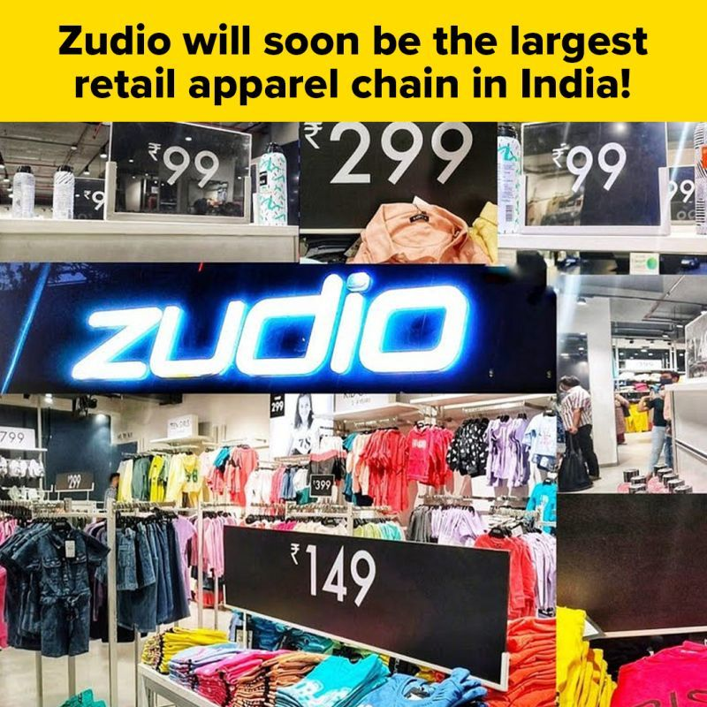
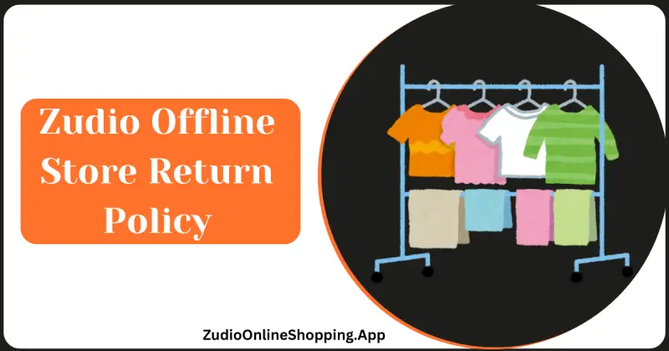
*awareness :
→social media,online advertisement,in stores display,word-of-mouth.
→ sees zudio’s brand or products,learn about the brands offering’s.
[fashion,affordability,accessibility]
2. Consideration
Channels: Zudio's website, mobile app, in-store browsing
* Customer Actions: Researches products, compares prices, reads reviews, checks store locations

Slide 3
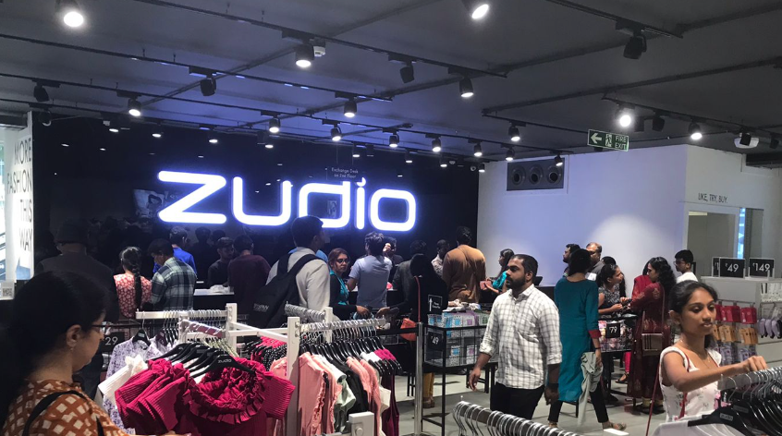
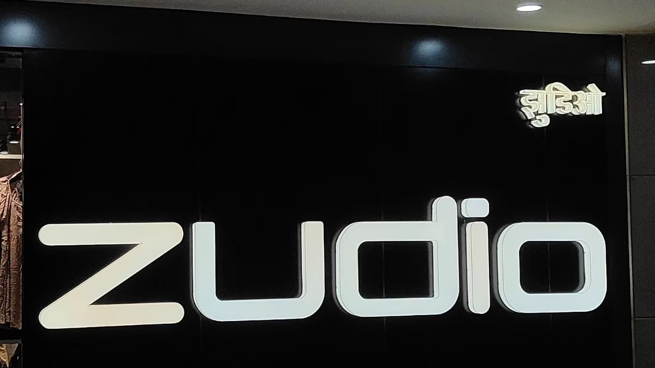
3. Purchase
Channels: Online store, physical store
* Customer Actions: Adds items to cart, proceeds to checkout, selects payment method, completes purchase
Usage/Experience
* Channels: Wearing the product, using the product
* Customer Actions: Evaluates quality, comfort, style, fits

Slide 4
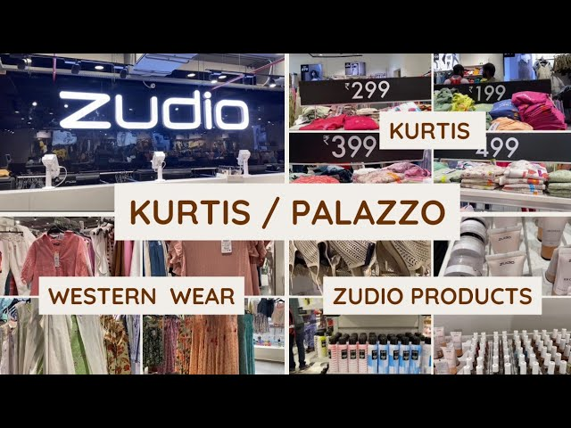
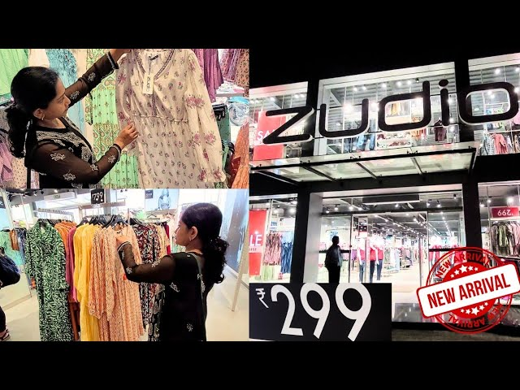
. Loyalty
Channels: Repeat purchases, referrals, social media engagement
* Customer Actions: Becomes a loyal customer, recommends Zudio to others, participates in loyalty programs

Slide 5
Key Considerations for Zudio's User Journey Map:
Mobile-first approach: Given the increasing use of smartphones, Zudio should optimize its online experience for mobile devices.
* Omnichannel integration: Ensure a seamless experience across online and offline channels, allowing customers to browse, purchase, and return products through their preferred method.
* Personalized recommendations: Utilize customer data to provide tailored product suggestions and offers.
* Easy returns and exchanges: Offer hassle-free return and exchange policies to build customer trust.
* Social proof: Leverage customer reviews and testimonials to build credibility and encourage purchases.
* Loyalty programs: Reward repeat customers with exclusive discounts and benefits.

